Slide 1
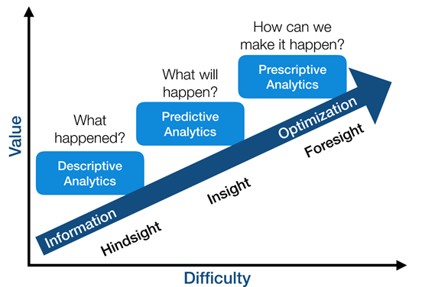
Team Member Selection based on Preferences in Project Assignments
Final Project MIS 64018
Alan D. Smith
Department of Marketing
Robert Morris University

Slide 2

Agenda
Introduction and General problem Statement
Project Description
Background
Why is individual preferences important?
Problem Definition
Subjective vs Objective Outcomes
Basic Solutions
Challenges of this Problem
Techniques
Experimental Evaluation
Credits

Slide 3

Introduction: Project Selection Criteria
The objective of forming groups.
Improvements in data science and the mass digitization of information resulted in computational analysis of decision marking.
The objective of this assignment is to define, formulate, and solve a mathematical optimization model.
Assume that your class consists of 12 students, and you would like to form 4 groups of 3 students each.
We want to maximize the chance that each group will do well on a class project.
I am going to write this assignment from a professional perspective, assigning individuals to research projects.

Slide 4

Problem Identification
Each group should have exactly 3 qualified individuals
Objective is to maximize the chance of success for each group on a project.
We must decide on factors affecting the success of our groups.
I originally wanted to set it up using the traditional LP model via lpsolveAPI, but decided against it.

Slide 5
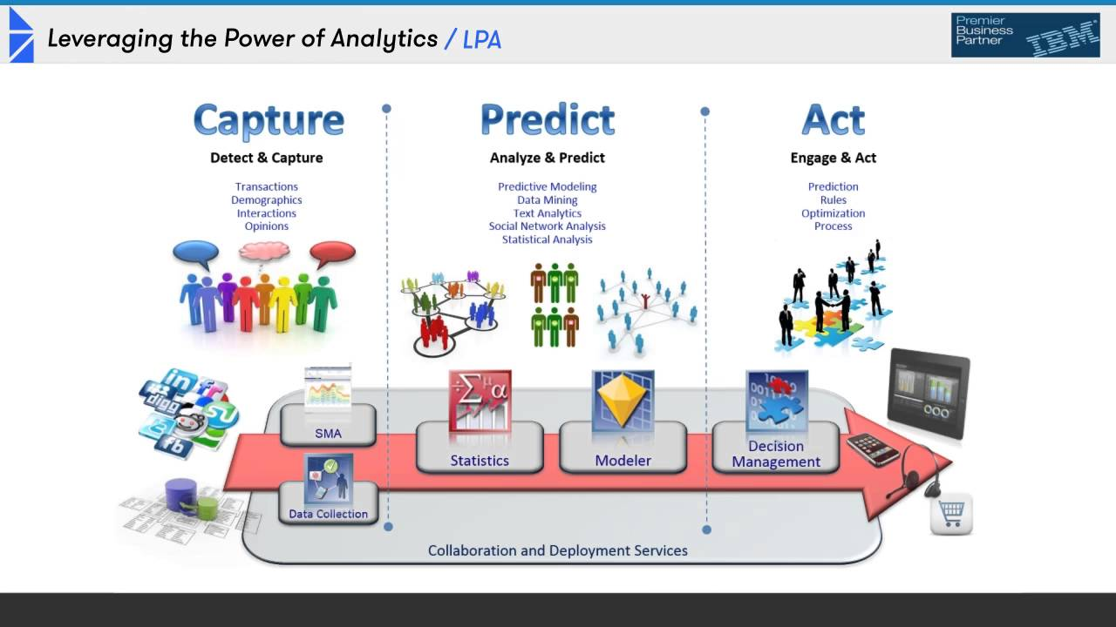
Algorithm Suggested
My Approach:
My factors of success (i.e. talent, emotional stability, expertise, gender preferences) are rarely predictive in group preferences and determining successfully interaction and performance.
Let each individual use the three factors.
Decide on their own weights for each factor.
Evaluate the individuals that are chairing each project group and generate a rating preference.
Members will choose their first group preference based on their highest score, followed by their second, and third choices

Slide 6
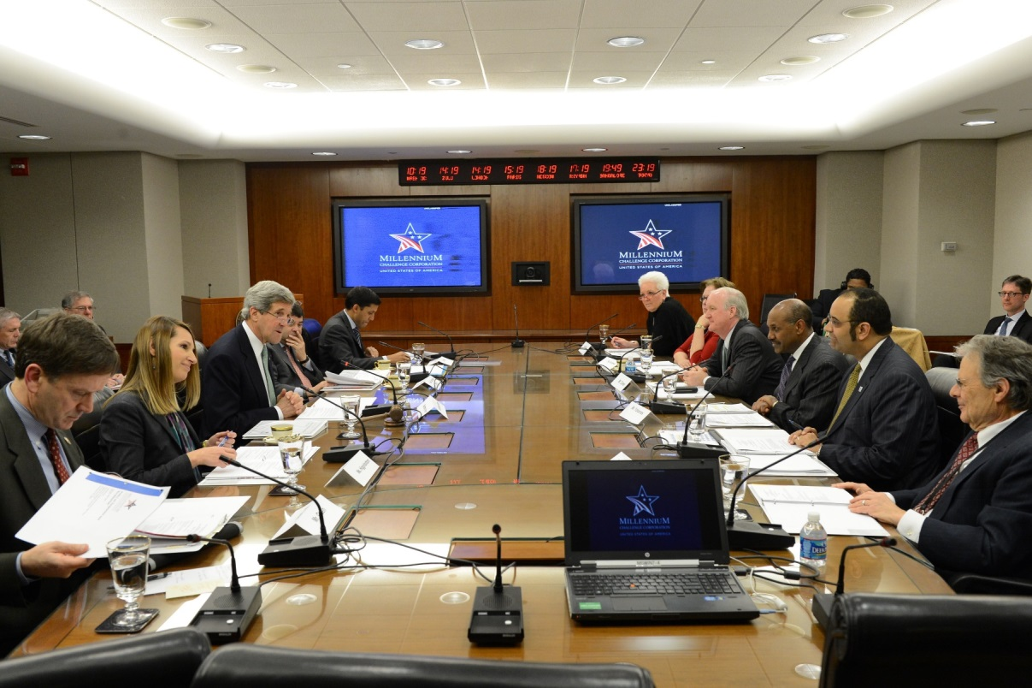
General Problem Statement
Members will choose their first group preference based on their highest score, followed by their second, and third choices.
Constraints:
Each group has the same capacity.
Assigned to exactly one group.
EV = weight1 (co-worker gender) + weight2 (relevant project experience) + weight3 (years of successful professional employment).
Maximize individuals receiving their best preference choices.

Slide 7

Project Description
Everyone has 3 preferences (first component has preference 1, second 2, and third 3.
Weight functions to make the model formulation easier.
This function gives us the preference weighting for a group and individual pair (-500000 penalty for not getting preference).
I created random preferences.
Plotted the number of votes for each available project grouped by the preference (1, 2, 3).

Slide 8
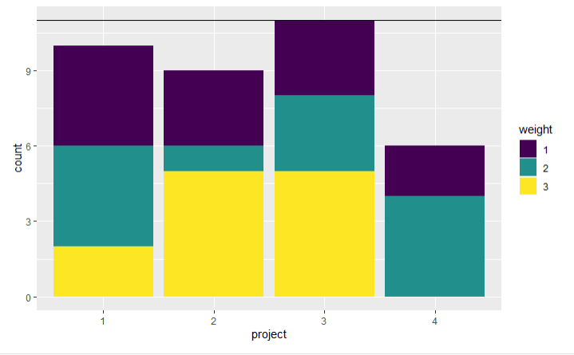
Libraries and Plot of Votes
library(ggplot2)
library(purrr)
library(dplyr)

Slide 9

Model Development
Introduce a binary variable xi,jxi,j that is 11 if student ii is matched to project jj.
As an objective we will try to satisfy preferences according to their weight.
Assigning a student to a project group with preference 3 gives 3 points, etc.
Total capacity of the project groups is enough for all students.
library(ompr)
library(ompr.roi)
library(ROI.plugin.glpk)
library(glpkAPI)

Slide 10
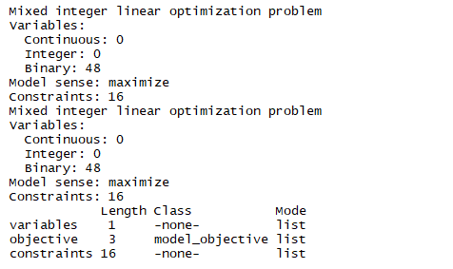
Model
Based on Hübscher, R. (2010). Assigning Students to Groups Using General and Context-Specific Criteria. IEEE Transactions on Learning Technologies, 3, 178-189.
Model sense is to maximize the potential members' preference rankings.
Mixed integer linear optimization problem.
Resulted in 48 binary variables.
16 constraints.

Slide 11
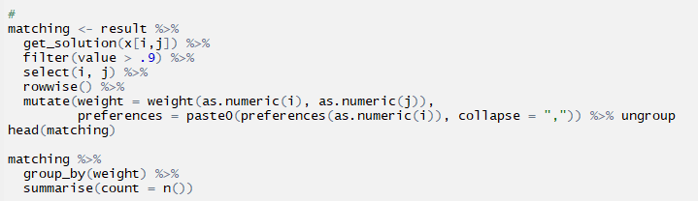
Solution
It was successfully solved.
We now need to match results with the solution for assignment to project groups.

Slide 12
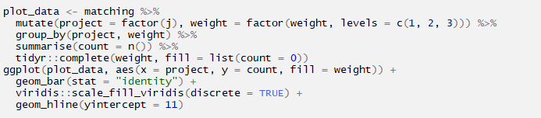
Matching Results and Successful Preference Selections
All 12 students/individuals got their top project preference (as expected). In total, 0 individuals were assigned to their second choice and 0 students/individuals got their least preferable project assignment.
The project group assignment now looks graphically by using ggplots after the following execution of code. Garg, et al. (2016) proposed a boosting algorithm, for the extraction of trajectories, on overall classification results when compared with the manual annotation, for individual behaviors (IPs) and group behaviors (GBs).

Slide 13
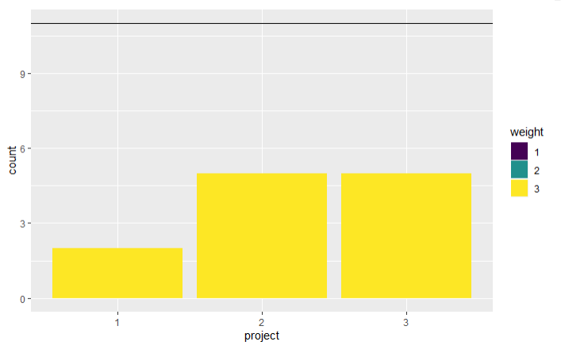

Slide 14

Conclusions & Limitations
Of course, with only 12 individuals, 3 project preferences among 4 groups, it was almost certain that we could accommodate them.
The challenge would be with a significantly larger n-size.
I used samples of 50+ and only had 2-3 persons not getting their 1st selection preference. None got their 3rd preference.

Slide 15

Credits
Thanks to Dr. Wu for a great course.
The MS in Business Analytics has been a great experience, but all things must come to an end.
Hopefully, I will graduate this term!

Slide 16

Questions?

